Slide 1
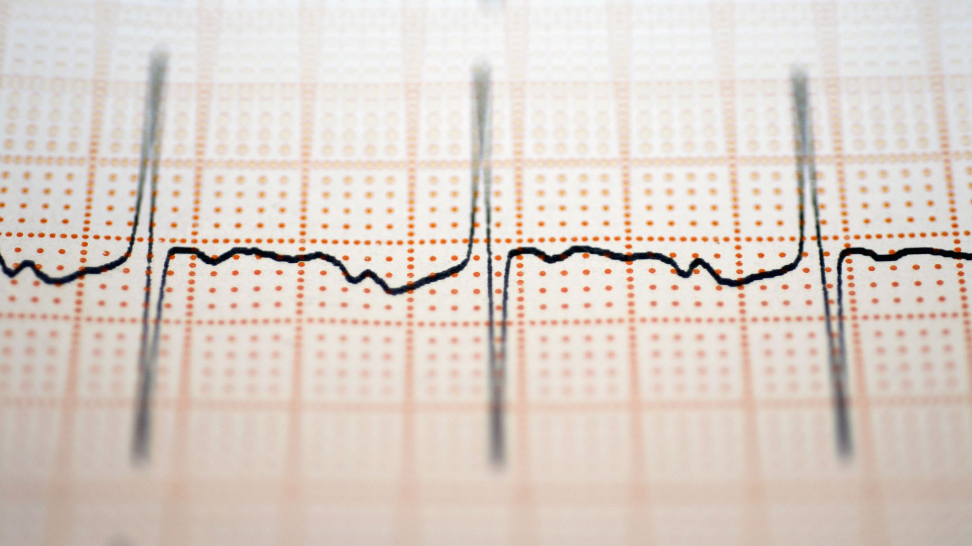
Medical Diagnosis System
Ahmed Mabood
Hafiz abdul basit
Saahil shahzad

Slide 2
Introduction
The Medical Diagnosis Expert System is a cutting-edge tool that uses Bayesian Networks to analyze user symptoms and predict potential medical conditions. Acting as a virtual assistant, it offers probabilistic insights, aiding individuals and professionals in making informed healthcare decisions
The System bridges the gap between technology and healthcare by improving diagnostic accuracy, accessibility, and dependability through its sophisticated reasoning and user-friendly interface.
This project highlights the transformative impact of AI in healthcare, showcasing how technology can enhance diagnostics and improve health outcomes.

Slide 3

Purpose Of The Project
Enhance healthcare decision-making with accurate and data-driven insights.
Simplify the diagnostic process for medical professionals and individuals.
Assist in early disease detection, reducing risks of delayed treatment.

Slide 4

DATASET
The main challenge of our project.
No available datasets that meet our requirements.
Countless disease prediction given symptoms datasets, each dataset lacked one of our many requirements.
So, we assumed the values ourselves merging information from various datasets.

Slide 5
What is Bayesian Network?
A Bayesian Network is a probabilistic graphical model that represents a set of variables and their conditional dependencies using a directed acyclic graph (DAG).
It is composed of two components:
Nodes: Represent random variables, which can be observed or hidden.
Edges: Directed links between nodes that indicate conditional dependencies

Slide 6
How Bayesian is used in our project
In our Medical Diagnosis Expert System, we use a Bayesian Network to model the relationships between symptoms and diseases. Here’s how it works:
Nodes Represent Symptoms and Diseases: Each symptom and disease is represented as a separate node in the network. The connections between them represent the dependencies that exist.
Conditional Dependence: The network shows how certain symptoms are conditionally dependent on specific diseases, illustrating how the presence of one symptom influences the likelihood of a particular disease.
Diagnosis Inference: Based on user-inputted symptoms, the system uses the Bayesian Network to calculate the probability of different diseases, providing the most probable diagnoses through Bayes' theorem.

Slide 7
Nodes And Edges Structure
Disease
Symptom 1
Symptom 2
Symptom 3
Symptom 4
Symptom 5

Slide 8

Formula:
$\text{P}\text{ ( }\text{D}\text{ | }\text{S}\text{ )= }\frac{P \left(S \right|D ) × P( D )}{P( S )}$
P (D | S) is the posterior probability of disease D given the symptoms S.
P (S | D) is the likelihood of observing symptoms S given disease D.
P(D) is the probability of disease D.
P(S) is the probability of symptoms S.

Slide 9
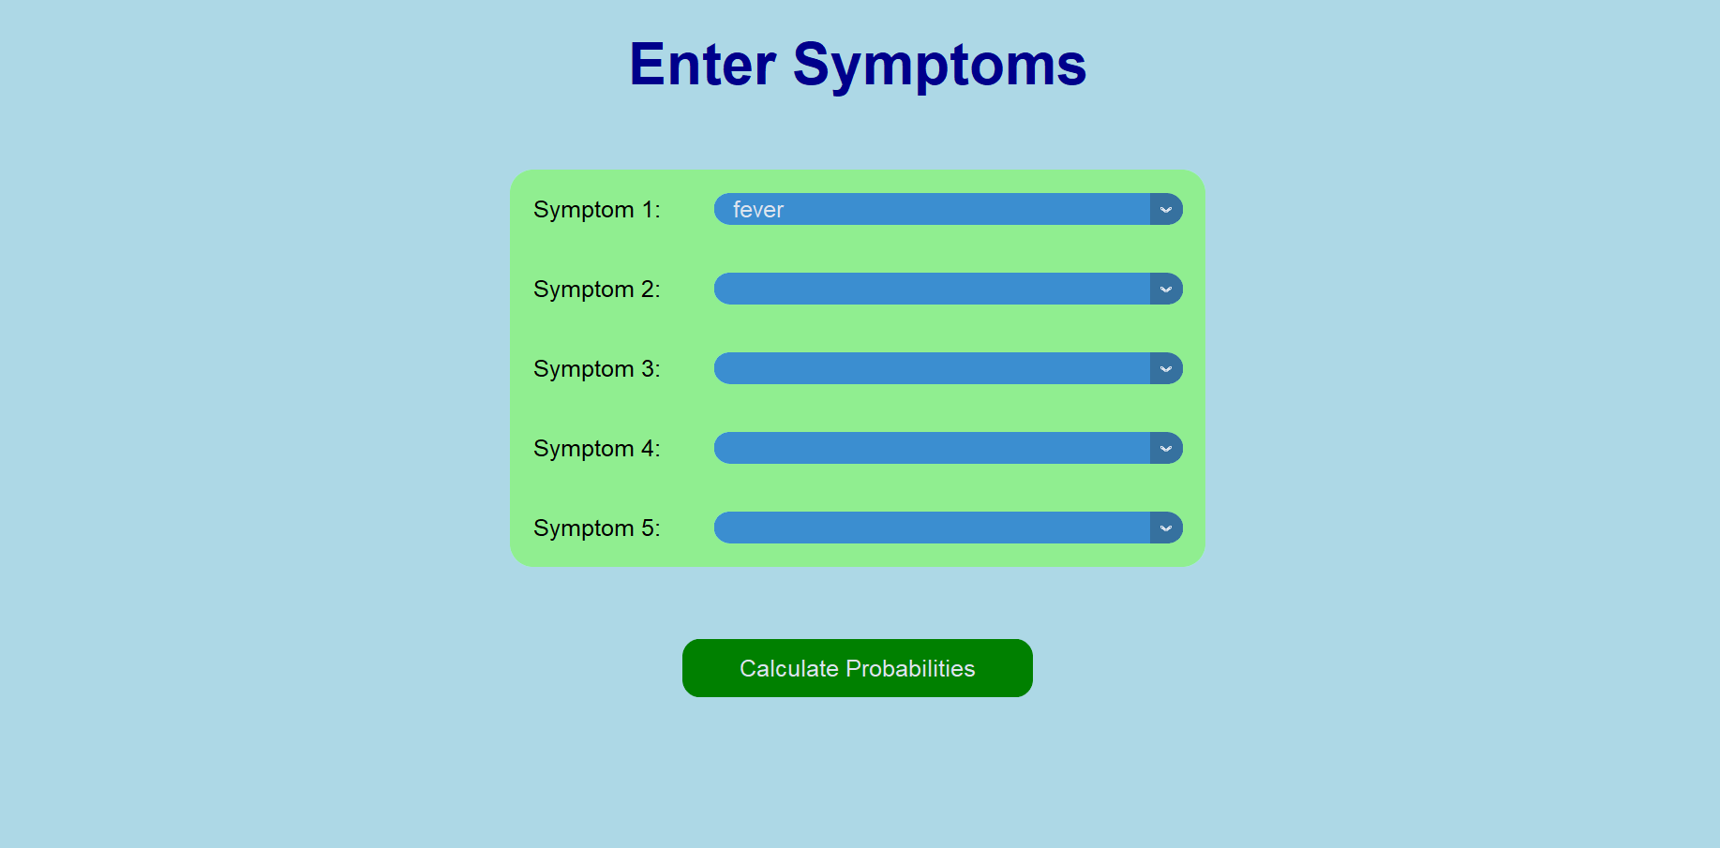
First test case:

Slide 10
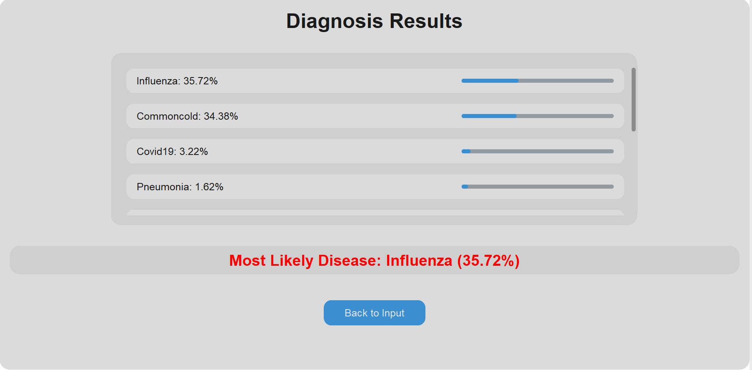
Output:

Slide 11
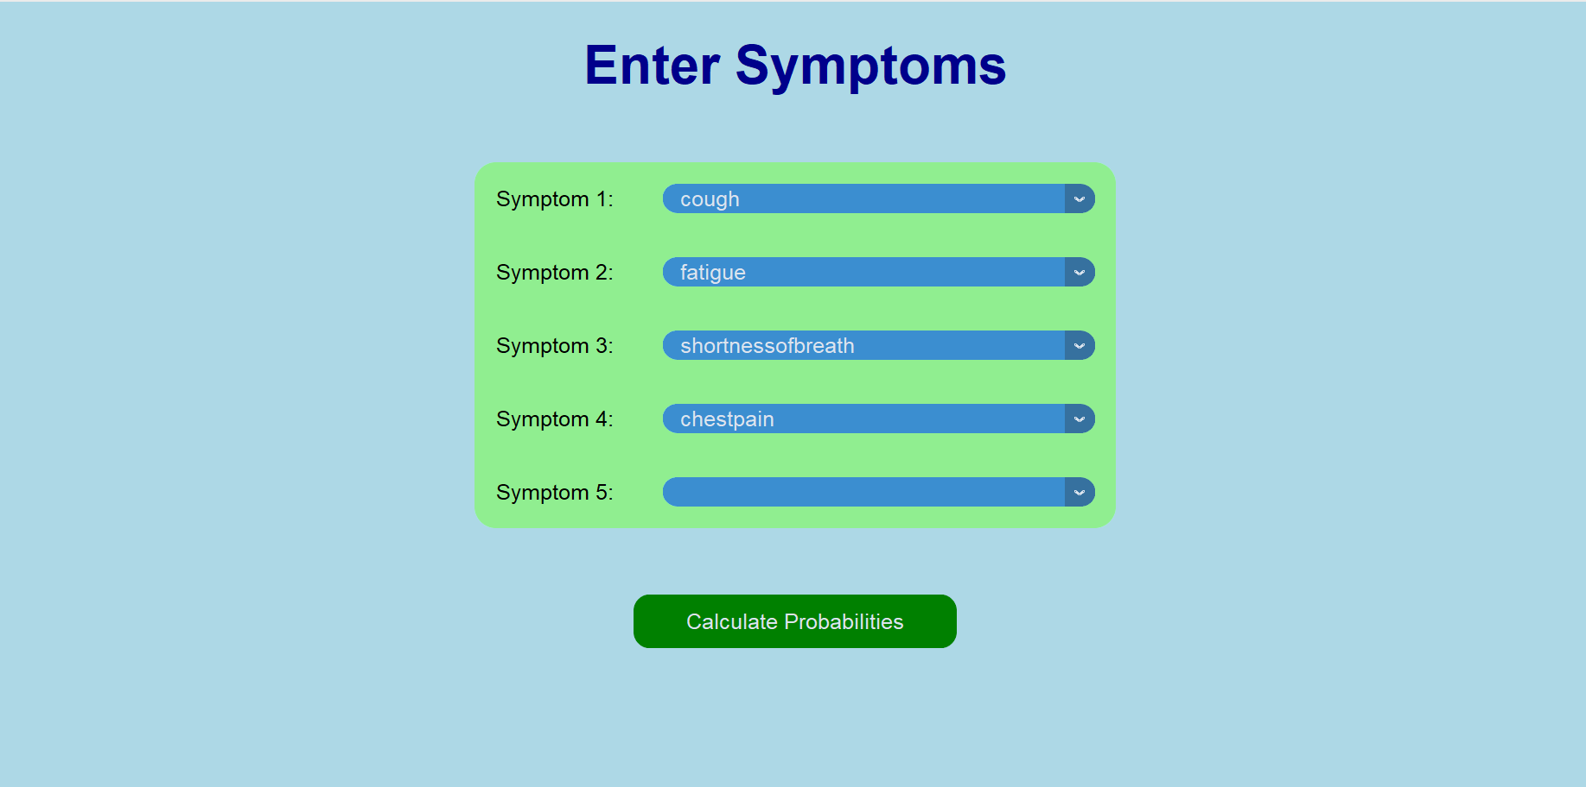
Second test case

Slide 12
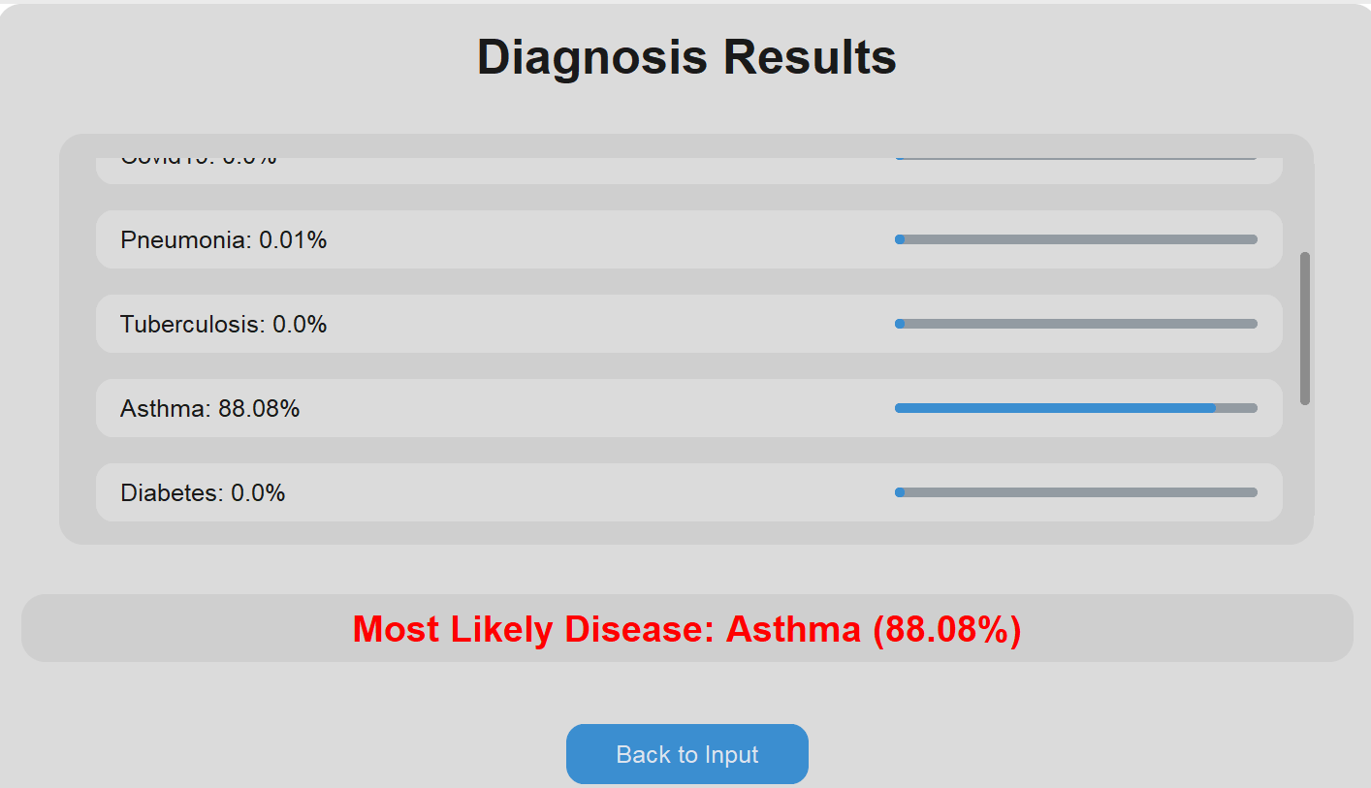
Output

Slide 13
Limitations:
Limited Dataset: Due to limited dataset the system might sometime produces incorrect results.
Lack of medical integration: The system does not integrate with electronic health records or medical devices for real time data collection
Static Probabilities: The probabilities of disease and symptoms does no change dynamically based on real-time data.

Slide 14
Improvements
Integrate with machine learning: By Integrating with Machine learning algorithms can make the system adaptive learning from user inputs and refining probabilities of diseases and symptoms over time
Larger Dataset: By enhancing our dataset, the system’s results can be more accurate and consistent
Integration with sensors: Integration of wearable or Iot-based sensors can allow the system to collect real-time medical data, improving diagnosis accuracy.

Slide 15

Any questions?

